Slide 1


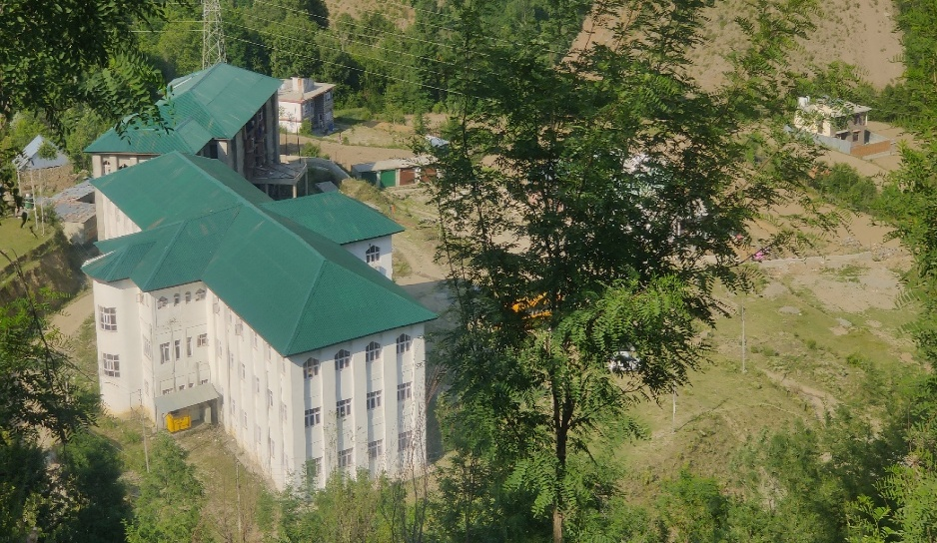
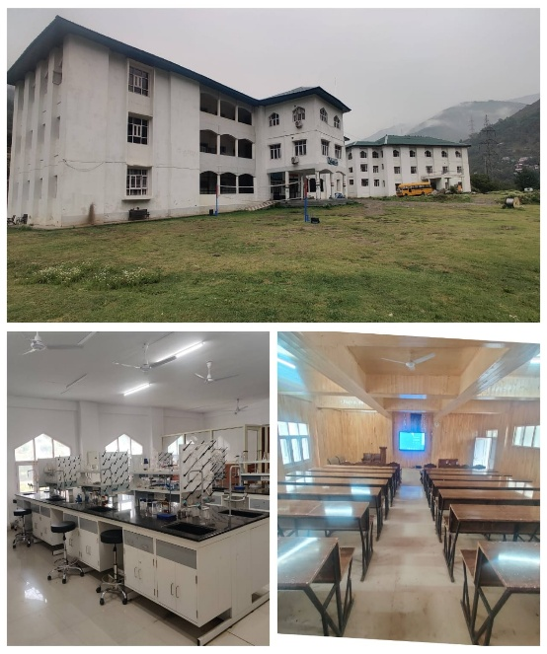
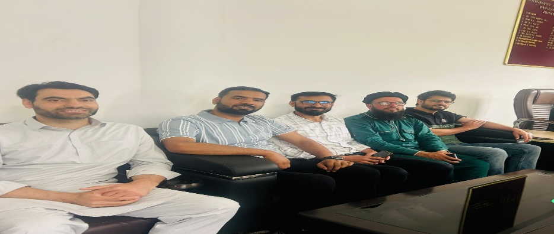
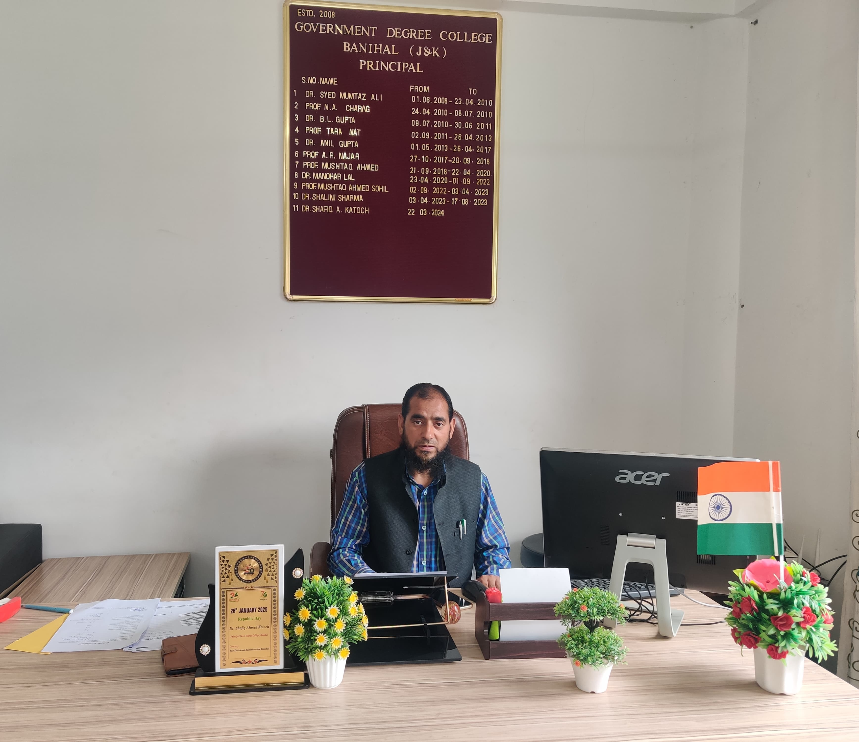
GOVERNMENT DEGREE COLLEGE BANIHAL
Apply through JKHED
JK Admission Samarth Portal
https: //jkadmission.Samarth.ac.in/index.php/site/login
* Start of online registration: 16th June, 2025
* Closure of online registration: 7 July, 2025
* Filling of preferences: 3rd July to 9 July, 2025
* Completion of online verification: 9th July, 2025
* Publication of Round 1 select list: 11th July, 2025
* Round 1 admission: 11th July to 15 July, 2025
For complete information click on the link: https://directorcollegesjk.in/Notices/39fec27f-a33f-4944-9913-d331cb42df6d.pdf
ADMISSION OPEN
For FYUG Programme (NEP) through Non-CUET
MAJOR COURSES OFFERED
ECONOMICS
HISTORY
POL. SCIENCE
URDU
BOTANY
ZOOLOGY
MINOR COURSES OFFERED
Arabic
English
Sociology
Education
Mathematics
Economics
Urdu
Physics
Botany
Chemistry
College Admission Committee
Principal
For Further information, contact Admission Coordinators:
Mr. Mohd Ashraf: 7006074561
Mr. Syed Kazim: 9906042060
Website: www.gdcbanihal.co.in

